Slide 1
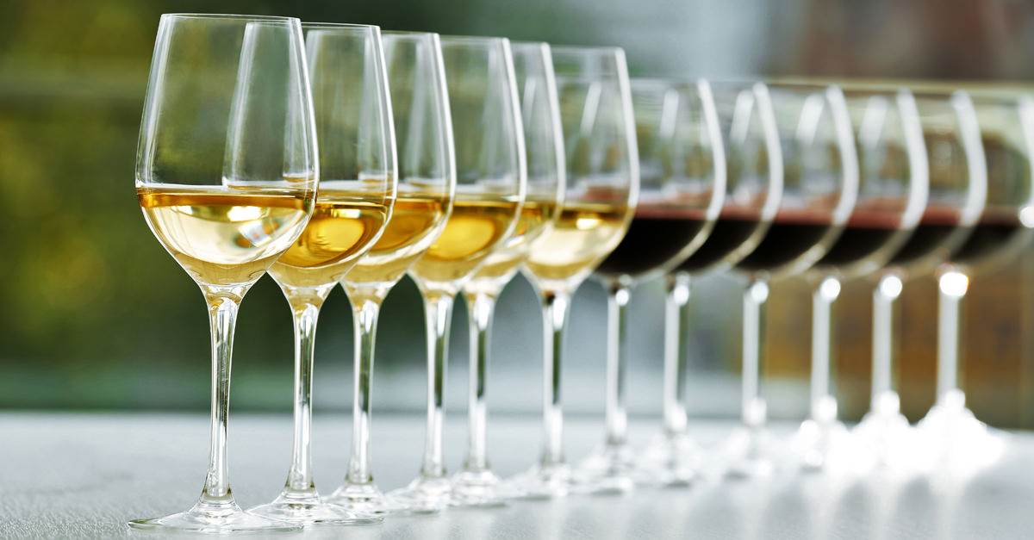
What Makes a Great Wine?
Analyzing 6,000 Red and White Wines to see if the same attributes make them great wines

Slide 2
Objective: Determine What Makes a Great Wine
-We will build a ML classifier that can predict if a wine is high quality or not.
-If the model is accurate, we will then compare the most impactful coefficients to determining the wine’s quality.
- Finally, we will assess if the same attributes contribute to high quality red and white wine.

Slide 3
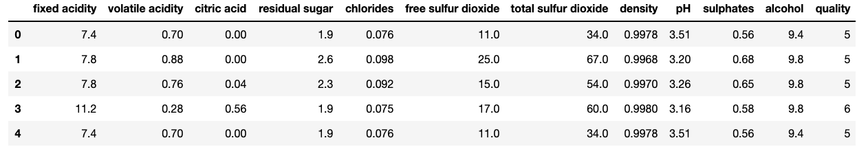
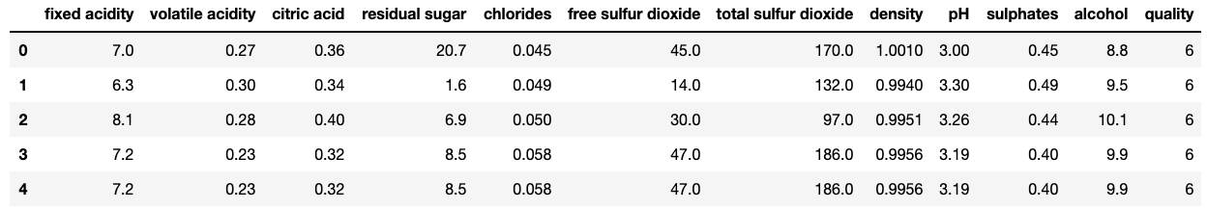
About the Datasets:
-Red Wine: 1599 rows about distinct Portuguese red wines.
-White Wine: 4898 rows about distinct Portuguese white wines.

Slide 4
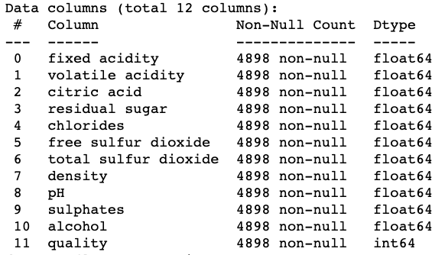
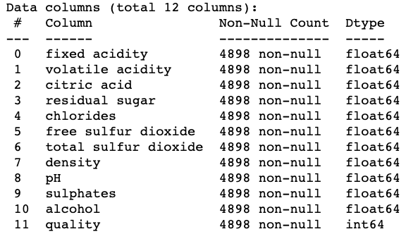
Variables in Datasets
Red Wine Info: White Wine Info:
-All columns are continuous numeric variables except for ‘quality’, which is a discrete ordinal numeric variable.

Slide 5
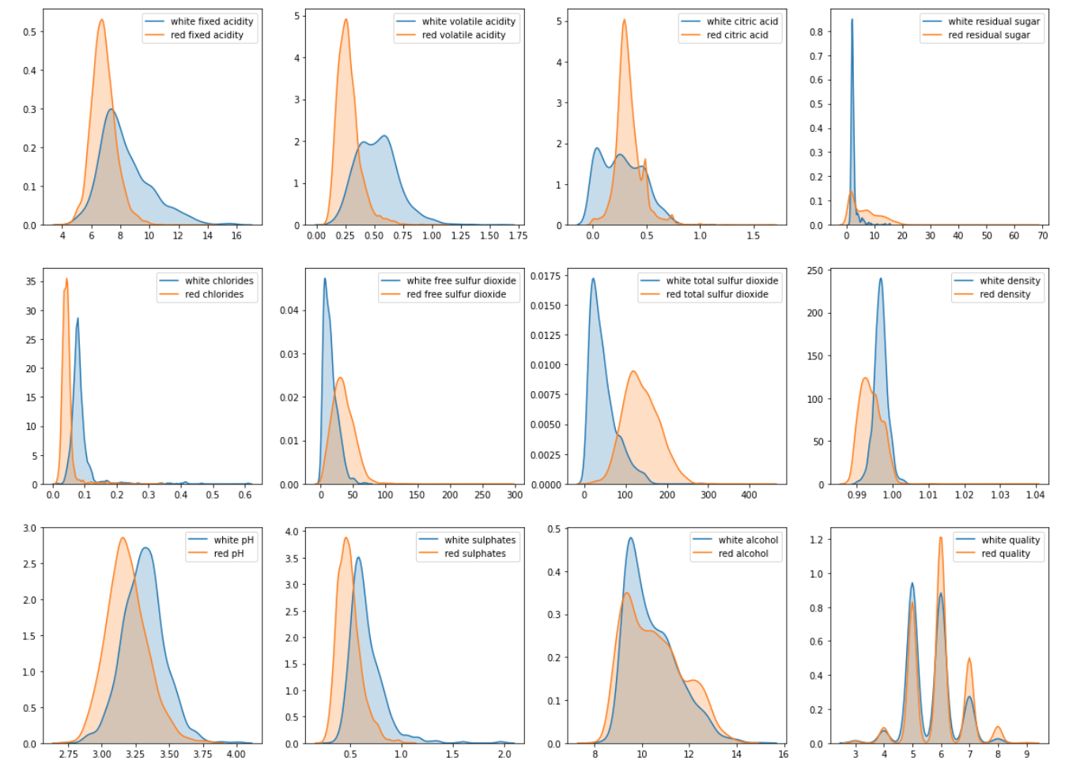
A Quick Comparison of Red vs. White Features
-It is evident that there are significant differences between the red and white distributions.

Slide 6
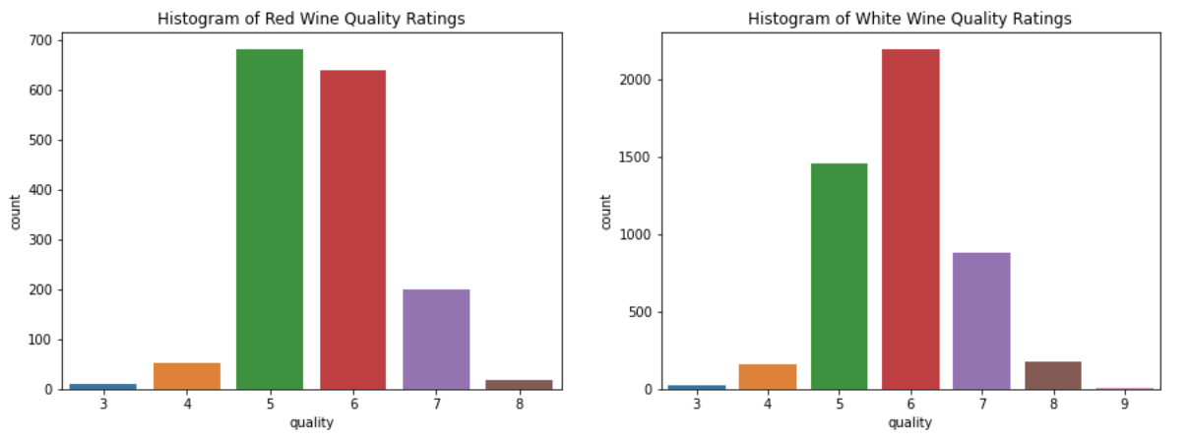
Red vs. White Quality Scores
-More scores of 5-6 range for Reds. Whites have a few(5) ratings of 9.
-Overall similar distributions here as well.

Slide 7
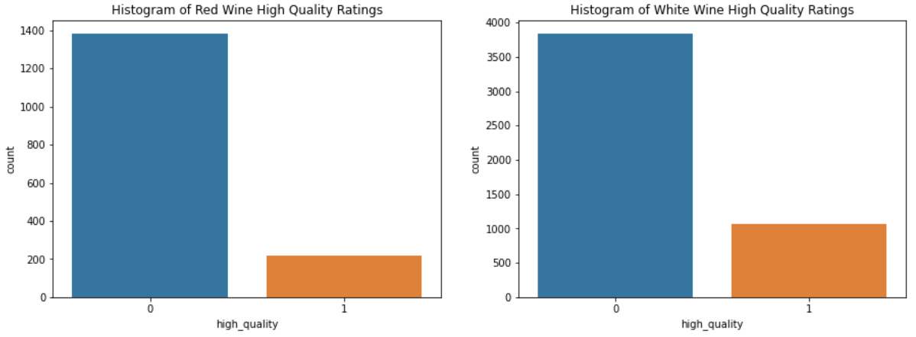
Reclassification
For the purpose of this model, we will classify wine’s with ratings 7 and above as a high quality wine with a boolean value of 1 and low quality with 0.
Here is the distribution of our new quality feature:

Slide 8
Modeling
For the purpose of this analysis we will will compare out of the box:
Logistic Regression
Random Forests
XGBoost.
Given the unbalanced value counts of the high quality wines, we will use F1-score to evaluate these models.

Slide 9
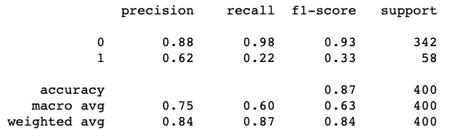
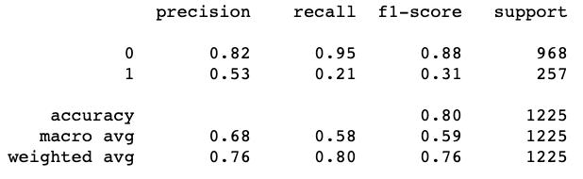
Logistic Regression Classification Report
Red Wine
White Wine

Slide 10
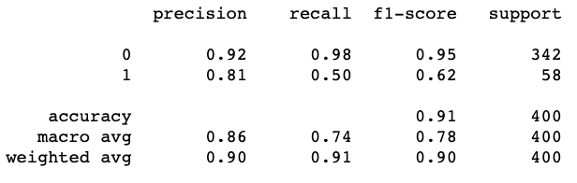
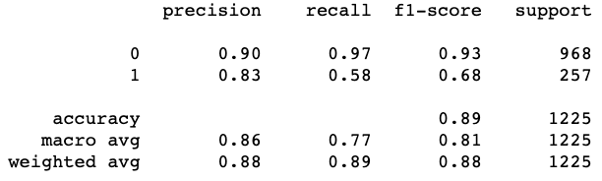
Random Forest Classification Report
Red Wine
White Wine

Slide 11
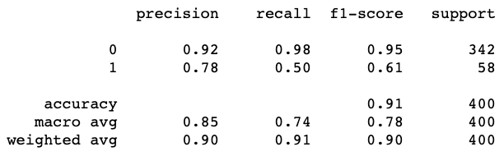
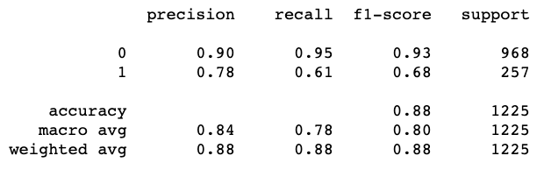
XGBoost Classification Report
Red Wine
White Wine

Slide 12
Evaluation
- Random Forest had F1 scores of 0.62(red) and 0.68(white) and XGBoost had F1 scores of 0.61(red) and 0.68(white).
- For further analysis and comparison of results we use the Random Forest Model for the next step of evaluation, comparing the the most important features between red and whites at predictioning high quality wine.

Slide 13
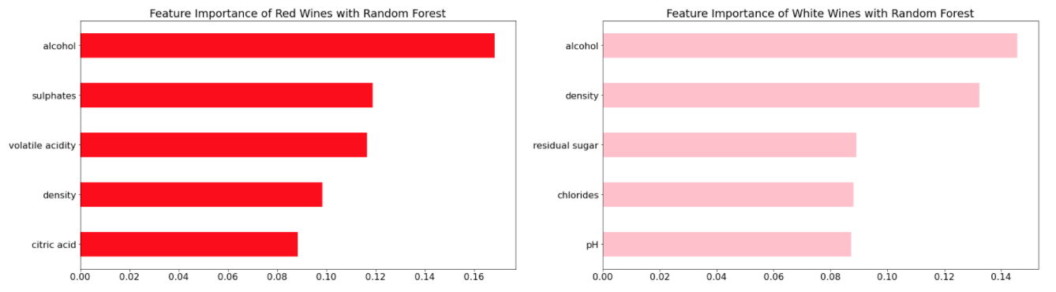
Feature Importance for Predicting Wine Quality
Analysis: For red and white models, alcohol is greatest predictor for quality. Beyond that, for reds, sulphates and volatile acidity are the next most important factors. For whites, density and residual sugar are the next most important features.
Conclusion: From these results we can conclude that beyond higher alcohol content, there are distinct attributes that determine a high quality wine. However, noting the Recall score for Reds was 0.5 but for Whites was 0.58, perhaps having a larger sample size would have increased model performance and highlighted different features as important.

Slide 14
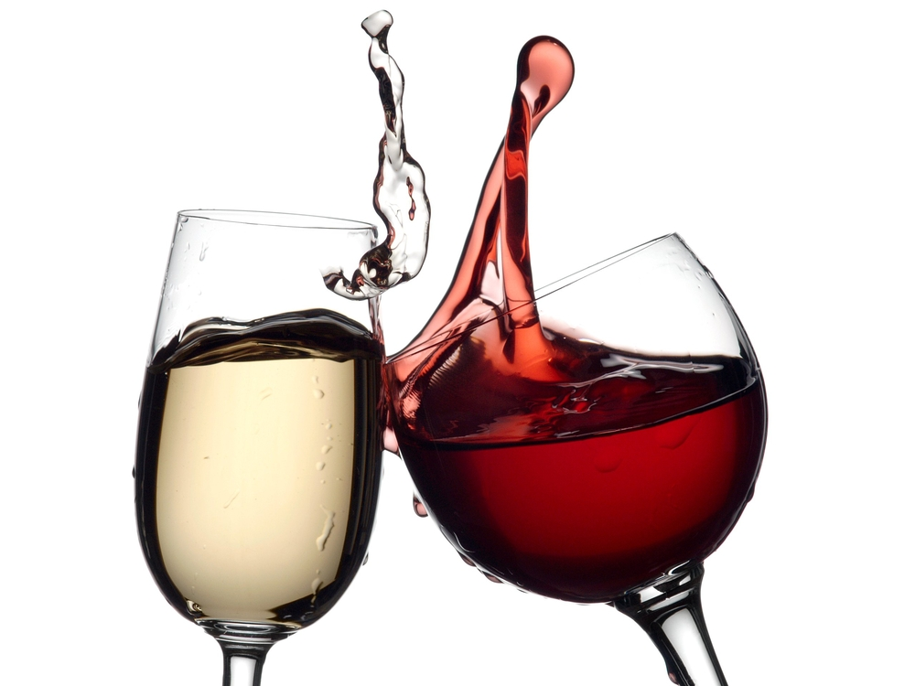
So next time you’re buying a bottle of wine, ask the Sommelier for a red wine high in alcohol, sulphides, and volatile acidity or a white wine high in alcohol, density, and residual sugar!
Cheers!

